Slide 1
Drainage UC Campaign Coverage all day’s Commulative
Description | NID OCT 2023 | NID OCT 2024 | SNID DEC 2024
Total HH Target | 86,559 | 102,361 | 102,361
HH Coverage | 79,702 | 77,546 | 77,030
HH Coverage % | 113% | 92% | 91%
Recorded NA | 15,092 | 15,277 | 14,199
Recorded REF | 1,317 | 2,066 | 1,847
Recorded Missed | 16,409 | 17,343 | 16,046
CoveredNA (Campaign+Catchup) | 12,964 | 12,688 | 10,731
Covered REF (Campaign+Catchup) | 1,091 | 1,429 | 1,000
Covered Missed (Campaign + Catchup) | 14,055 | 14,117 | 11,731
Same Day Coverage % (target 40% ) | 43% | 42% | 47%
Still NA | 2,128 | 2,589 | 3,468
Still Refusal | 226 | 637 | 847
Total Still Missed | 2,354 | 3,226 | 4,315
Still Missed % of Recorded (target 5%) | 14% | 19% | 27%
Still Missed % of MP Target (target 0.75%) | 2.72% | 3.15% | 4.22%
TOTAL Zero DOSE reported | 1,421 | 1,752 | 1,519
AFP cases reported | 5 | 10 | 5
Total HRMP covered | 9,053 | 15,669 | 17,259
Children covered in Schools | 4,345 | 4,104 | 3,723
Guests Covered | 6,009 | 5,362 | 5,365
Households Planned | 93505 | 96648 | 97706
Households Visited | 94364 | 97741 | 98294
Household Target (Reached/ Reported) | 77,433 | 76,373 | 79,677
HH Coverage + Same day Covered Children | 79,702 | 77,546 | 77,030
Total HH Coverage% of Reported MP | 103% | 102% | 97%
HH Coverage %of Total Target | 92% | 76% | 75%

Slide 2
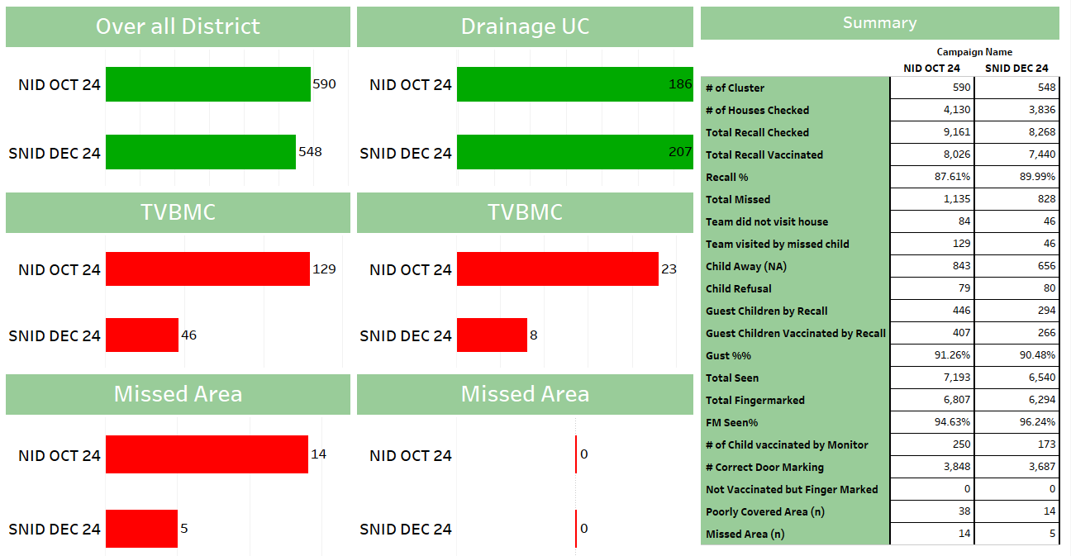
Commulative all Days District Summary
87.61%
89.99%
94.63%
96.24%

Slide 3
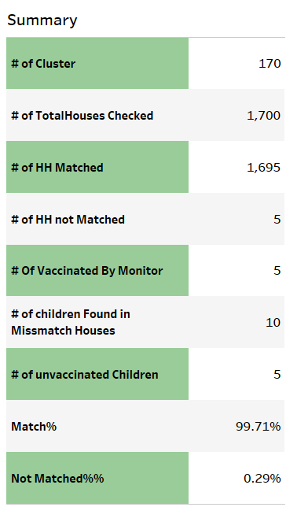
CATCHUP CLUSTERS (0/0, Locked, Refusal, NA Houses)
Category | 0/0 | Lock | Refusal | NA | Total
#ofCluster | 95 | 15 | 5 | 55 | 170
# of Total Houses | 955 | 154 | 46 | 545 | 1700
# of HH Matched | 952 | 154 | 46 | 543 | 1695
Matched% | 99.7% | 100.0% | 100.0% | 99.6% | 99.7%
# of HH not Matched | 3 | 0 | 0 | 2 | 5
Not Matched% | 0.31% | 0.00% | 0.00% | 0.37% | 0.29%
# of total children | 5 |  |  | 5 | 10
# of unvaccinated Children | 4 |  |  | 1 | 5
# of vaccinated by monitor | 4 |  |  | 1 | 5

Slide 4
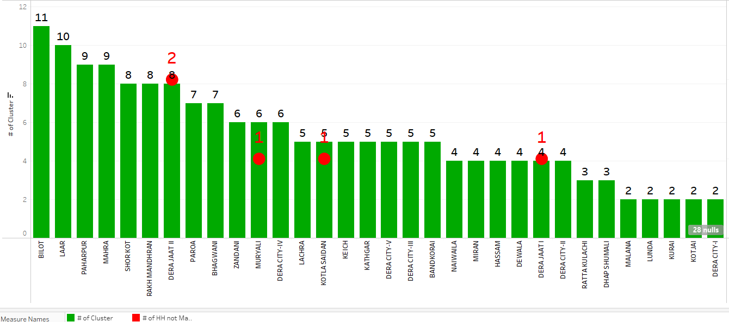
170
Total Number of Cluster
1695
HH Matched
05
HH Not Matched

Slide 5
Designation wise Cluster NEOC APP
ICM CLUSTERS
CATCHUP CLUSTERS (0/0, Locked, Refusal, NA Houses)
Designation | #of Clusters | TMH | TVBMC
Area Coordinator / District Coordinator | 2 | 0 | 0
DSV / ASV | 3 | 0 | 0
EPI Coordinator | 3 | 0 | 0
Federal/Provincial/District Facilitator | 8 | 0 | 2
Immunization Officer | 2
UCMO | 149 | 0 | 1
District NSTOP Officer | 7 | 0 | 0
UCPO / UCSP/ UCDO | 363 | 36 | 38
TPO/ TDO | 34 | 13 | 8
TTSP/TUSP | 1 | 0 | 0
Provincial Facilitator (EPI, Coordinator etc) | 3
Grand Total | 575 | 49 | 49
Designation | 19-Dec | 20-Dec | Total
INT_CONS | 2 | 1 | 3
Other | 17 | 23 | 40
TPO | 1 |  | 1
UCPO | 11 | 11 | 22
ucsp | 54 | 50 | 104
Total | 85 | 85 | 170
398

Slide 6
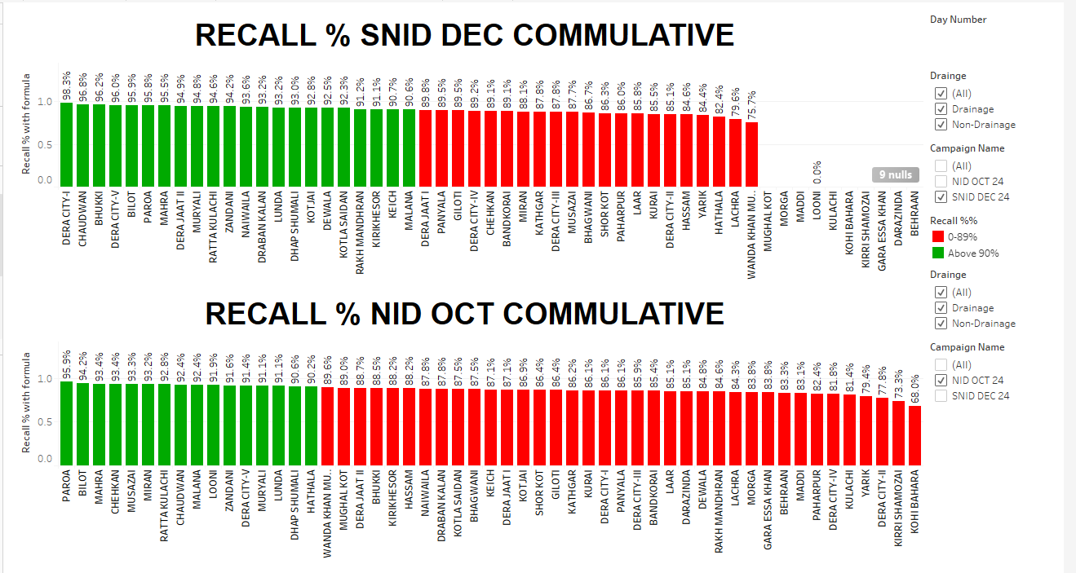

Recall %

Slide 7
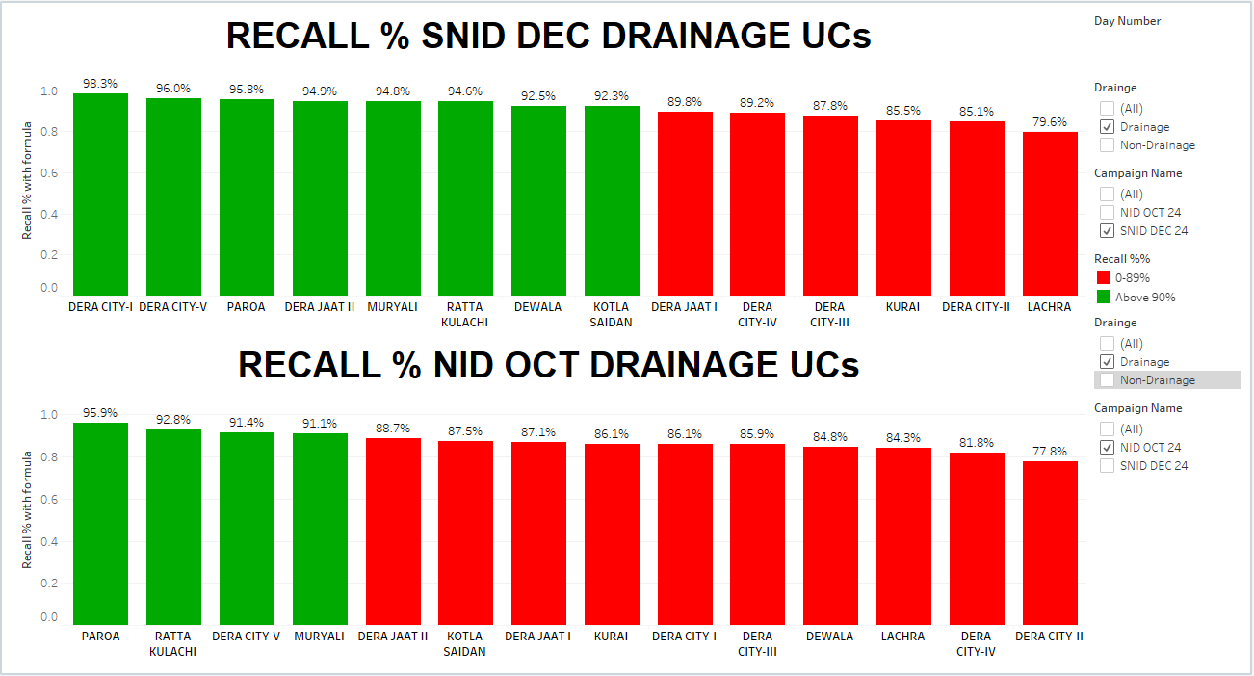
DRAINAGE UCS RECALL %
06
08

Slide 8
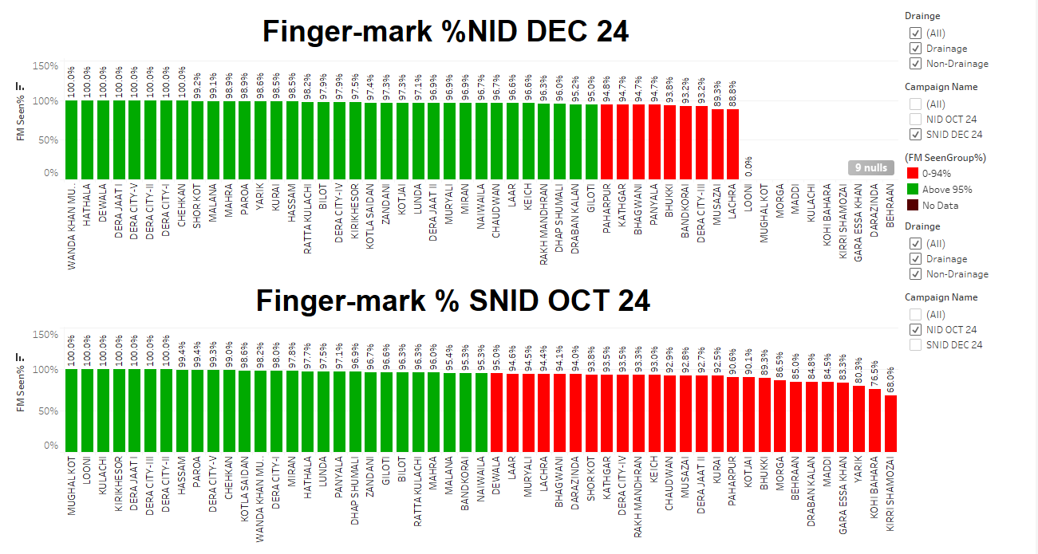
FINGER-MARK %

Slide 9
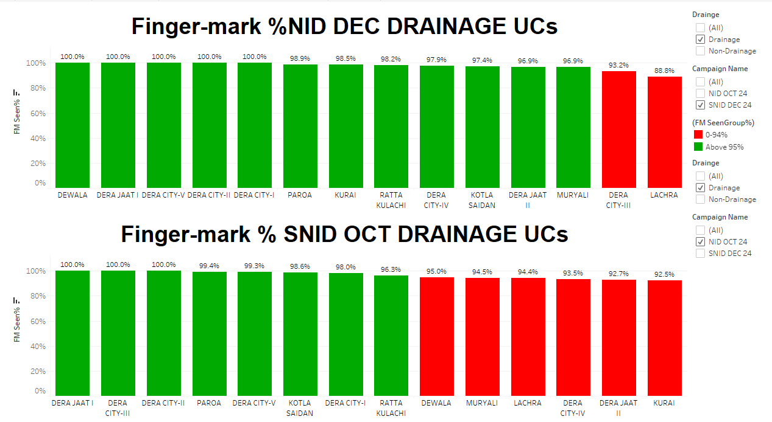
DRAINAGE UCS SNID FINGER MARK %

Slide 10
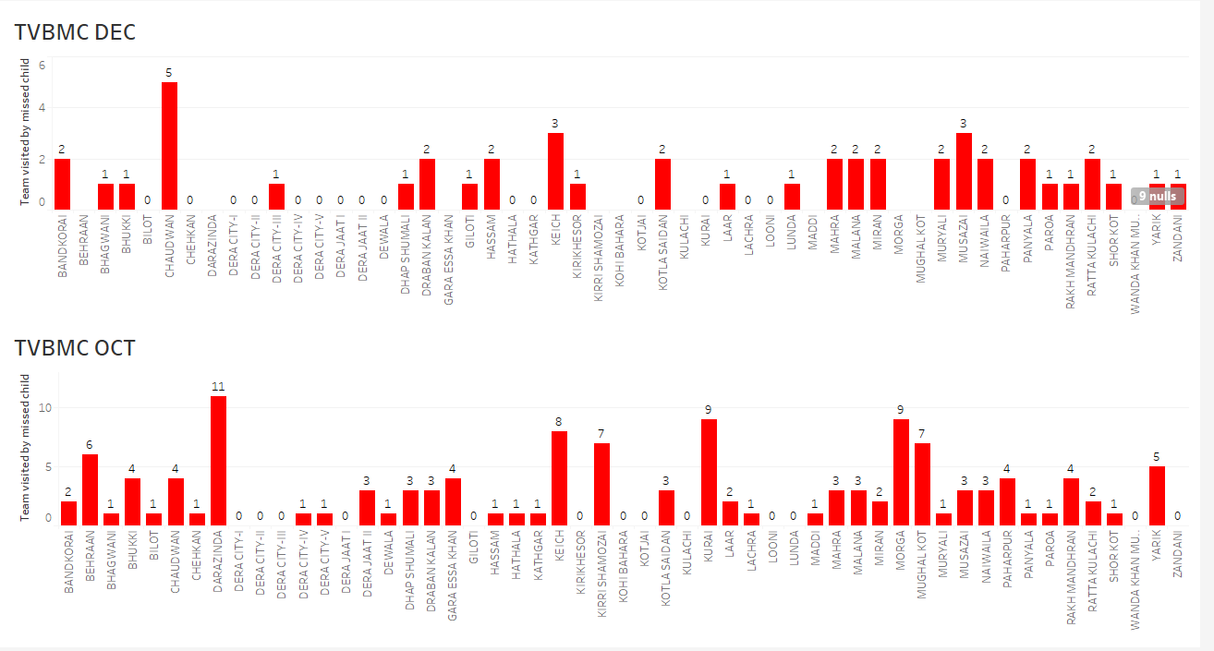
46
129

Slide 11
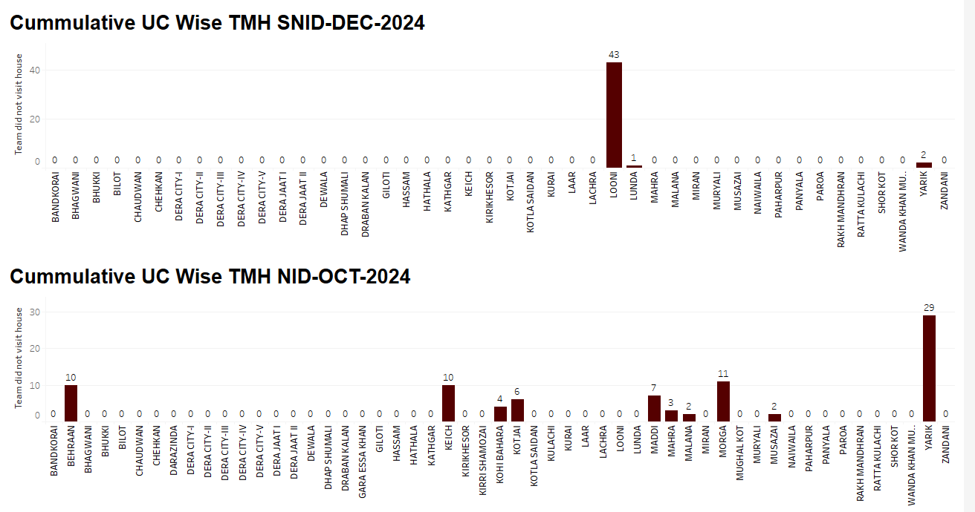
46
84

Slide 12
TVBMC
UC | AIC Name | Village_name_begin | Team No | TVBMC
BANDKORAI | fareed | zandar | 3 | 2
BHAGWANI | Salma Punu | khanewala | 3 | 1
BHAGWANI | Aziz | Kamboh | 1 | 2
BHUKKI | saima imam | Zarkani | 1 | 1
CHAUDWAN | Javed | Gatar | 3 | 3
CHAUDWAN | M Javid | Basti machi | 4 | 1
CHAUDWAN | Hafza bb | Moh Badanzai | 1 | 1
DERA CITY-III | Madiha | Mukhtiyar wali Gali | 4 | 1
DHAP SHUMALI | Kamran | Rakh Civil | 3 | 1
DRABAN KALAN | Saimaa imam | Koot lalu | 5 | 1
DRABAN KALAN | saima imam | Koot lalu | 2 | 1
GILOTI | Ghulam Mustafa | Abu wanda | 6 | 1
HASSAM | Qudratullah | Bagu boring | 1 | 2
KEICH | M.Arif | Alfalah Colony | 3 | 2
KEICH | Younas | ghabi | 1 | 1
KIRIKHESOR | Ejaz | Mary wala | 4 | 1
KOTLA SAIDAN | Noman | MMP | 4 | 1
KOTLA SAIDAN | M Usman | syed Nagar | 2 | 1

Slide 13
TVBMC
UC | AIC Name | Village_name_begin | Team No | TVBMC
LUNDA | M Suleman Saim | Adil Sipra | 4 | 1
MAHRA | zahoor Ahmed | langrah | 3 | 2
MALANA | samiullah | Masood Abad | 2 | 2
MALANA | Farman | Ahsan Town | 5 | 1
MIRAN | Alamgeer | Masood kaloni | 5 | 2
MURYALI | zeenat Bibi | Noor Sultan Colony | 4 | 1
MURYALI | Ummar Farooq | new Muryali Bilal abbbad | 2 | 1
MUSAZAI | Nooren | Musazai | 6 | 1
MUSAZAI | M Ihsan | Kot shah nawaz | 3 | 1
MUSAZAI | Noreen Akhtar | Moh Faqeer shiekh | 4 | 1
NAIWAILA | zahida Bibi | jatta road | 4 | 2
PANYALA | Salman | Said Abad | 12 | 1
PANYALA | Salman | Gharib abad | 2 | 1
PAROA | ashraf bibi | makar road | 1 | 1
RAKH MANDHRAN | Fayyaz | Jhoke Lala | 2 | 1
RATTA KULACHI | Haroon | Fish farm | 2 | 1
RATTA KULACHI | Abdul hakeem | basti kaneria | 2 | 1
SHOR KOT | Akhtar | Baghe Naran | 3 | 1
YARIK | Muhammad Ishfaq | Mohallah Basti Nizamdin | 3 | 1
ZANDANI | abbas | jalebi chowk | 2 | 1
Grand Total |  |  |  | 49

Slide 14
Missed Area
UC | AIC Name | Village_name_begin | Team No | TMH
KOTLA SAIDAN | sulman | burki town | 2 | 3
LOONI | ikram | Gara Bakhtyar | 2 | 12
LOONI | ikram | Garah Bakhtiar | 2 | 18
LOONI | ikram | Garah Bakhtiar | 4 | 13
LUNDA | shafiq | Juma Sharif | 2 | 1
YARIK | Muhammad Ishfaq | Bhatta Sher han | 2 | 2
Grand Total |  |  |  | 49

Slide 15
Not Matching DETAIL
UC | TYPE | AIC Name | Team No | Village | Head Name | HH Remarks | Total Children | un vaccinated | vaccinated
DERA JAAT I | 0/0 | Rabia | 5 | Masjid Abu Bakar street- Ameer City | Farid ullah | (blank) | 2 | 2 | 0
DERA JAAT II | 0/0 | Saima Rafeeq | 1 | Kotli Imam Hussain | haider | (blank) | 1 | 0 | 1
DERA JAAT II | NA | Saima Rafeeq | 1 | Kotli Imam Hussain | bilal | (blank) | 2 | 1 | 1
KOTLA SAIDAN | 0/0 | Ghulam Subhani | 2 | Arra | Ayuab Khan | These children were guests here from uc zandani and had been here for six days- but there was door c | 2 | 2 | 0
MURYALI | NA | Shamoona Rehman | 2 | Musa Town | Younis | 3 Child vaccinated in house but show on Chalking 2 Child | 3 | 0 | 3
Grand Total |  |  |  |  |  |  | 10 | 5 | 5

Slide 16
Reported leftover
UC | Area Name | Day | Area Number | # of Team | Final leftover HH | Final Left Over
MIRAN | Sara Gara | 1.2.3 | 5 | 4 | 662 | 834
MIRAN | Ganjo | 1.2.3 | 6 | 4 | 680 | 1476
zandani | khaliqdad | 1.2 | 10 | 2 | 15 | 36
Chehkan | Chehkan | 3 | 1 | 1.2.3.4 | 243 | 310
Chehkan | potah | 1.5 | 2 | 1.2.3.4 | 378 | 361
Yarik | Sadra | 1 | 4 | 6 | 308 | 475
HATHALA | Mohabat 1 | 1 | 2 | 8 | 401 | 595
HATHALA | Mohabat. 2 | 1 | 11 | 8 | 393 | 589
HATHALA | Kanorry | 1 | 6 | 6 | 323 | 410
Chehkan | shero kohna | 3 | 8 | 1.2 | 176 | 228
Chehkan | Kot essa khan | 1 | 5 | 1.2.3.4.5.6 | 312 | 310
Chehkan | drabri | 1 | 6 | 1.2.3.4.5.6 | 337 | 392
HATHALA | Takwara | 1 | 1 | 7 | 345 | 368
HATHALA | Malang | 1 | 5 | 6 | 207 | 286
HATHALA | Kerry bahadar khail | 1 | 8 | 7 | 371 | 299
Panyala | Panyala 1 | 1 | 1 | 1,2,3,4,5,6,7,8,9,10,11,12 | 811 | 546
Panyala | Panyala 2 | 1 | 2 | 1,2,3,4,5,6,7,8,9,10,11,12 | 842 | 497
Panyala | Khanqa yasin zai | 1 | 4 | 1 | 20 | 25
WKM | Abdulkhel | 1 | 1 | 16 | 858 | 829
WKM | sheru | 1 | 6 | 12 | 504 | 567
WKM | talgi | 1 | 2 | 12 | 600 | 750
WKM | badnikhel | 1 | 3 | 12 | 580 | 729
WKM | lohani | 1 | 4 | 9 | 448 | 764
WKM | laali | 1 | 5 | 9 | 500 | 747

Slide 17


